Slide 1
British Cochlear Implant Group 2024 Crystal Report
Sam Blakemore – University Hospitals Sussex
Lushinka Gopichand – East Suffolk and North Essex NHS Foundation Trust
Nicaida Samuel-Huggins – Somerset NHS Foundation Trust

Slide 2
CIRR
Cochlear Implant Referral Report
Data processing – Identify those audiometrically eligible for CI (NICE 2019) https://www.nice.org.uk/guidance/TA566
Collaboration – Auditdata, Cochlear, Pilot sites
Learning – Identify opportunities for learning, service evaluation and potential change
Research - Contribute and grow evidence base

Slide 3
Loading reports into Practice Navigator
The ‘Report settings for PN’ should look something like the image below.
Log into Report Builder
Click on the ‘New Report’ button at the top of the screen
Select ‘Load from File’ from the ‘File’ menu on the toolbar
Browse to the location of the reports, select the report and click the ‘Open’ button.
The report should now be displayed on your screen
Select ‘Save as’ from the File menu on the toolbar
Once the report has been saved, select ‘Close’ from the ‘File’ menu on the toolbar to return to the report explorer screen
If you wish to view the reports in Practice Navigator they must be activated - restart.
CI Champions Resources - British Academy of Audiology |British Academy of Audiology (baaudiology.org)
Notes:
The British Cochlear Implant Group (BCIG) has a Crystal report developed after excellent collaboration between Auditdata and Cochlear.
The BCIG Referral Report allows Audiology departments to identify and analyse patients who fall within CI audiometric candidacy guidelines in a time-efficient way. Audiologists can monitor what happens to their patients’ referral status over time, and identify initiatives to improve their referral practice. The BCIG can help you find one-to-one support in using the report, analysing the results, and setting action plans.
A list of patients and their audiograms can then be saved into excel and manipulated to find the patients that meet the NICE criteria.
Search by clinics: e.g. look through your S&P/complex clinics to find those that meet the criteria according to PTA – see talk from BAA 2019 and BCIG 2020
For Private dispensers such as Spec savers – there is a resource hub where you can find referral and outcome letters.

Slide 4
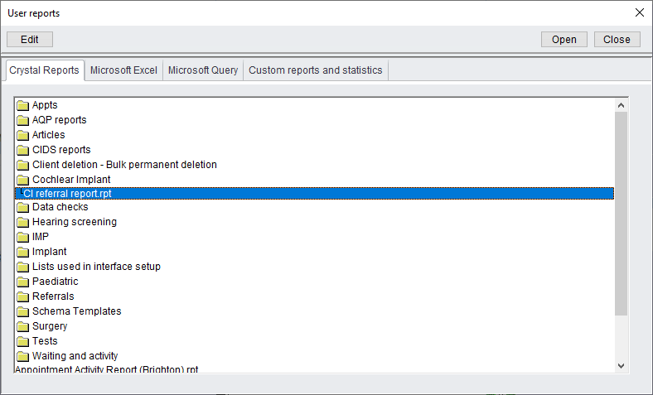
Where is the report? (in AB 6.4)
Clinic management tab
User reports
CI referral report

Slide 5
No access to the report?
Auditdata
support@auditdata.com
0333 444 4212
Local IT department
BAA
admin@baaudiology.org

Slide 6
Setting the date range / output
Choose Yes to alerts
Choose start and end dates
Choose anonymised if sending to Cochlear for processing

Slide 7
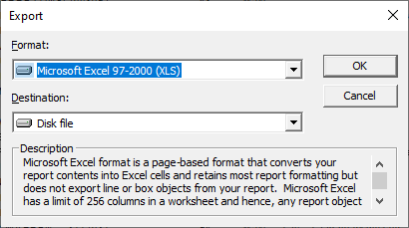
Export data to Excel
Choose export icon (top L)
Then select Excel
And
Disk File

Slide 8
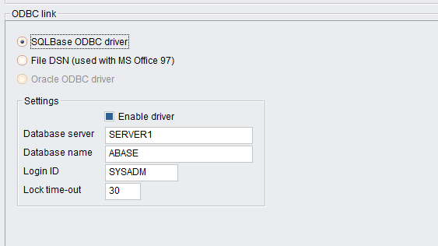
ODBC Error?
Set up driver via System Admin
Enable driver (autofills)

Slide 9
Report format

Slide 10
Setting up Parameters (*Gold standard)
Parameter | Definition | When to use
C1* | Referred for CI | Referral made to a CI centre
C2* | Not referred – unsuitable / outside of criteria | Eg if aided AB scores are outside of referral criteria Eg if BAHD more appropriate Eg ?pre-existing medical conditions
C3* | Not referred – discussed and further assessment needed | Eg if awaiting outcome of aided AB speech testing Eg if PTA results may not be accurate Eg not optimally aided yet
C4* | Not referred – pt declined | Offered referral but declined by patient
C5 | CI to be discussed | No record that CI discussion took place
C6* | Under assessment | Referred and CI centre have accepted referral
C7* | CI patient | Already has CI
Notes:
Set up varies depending on version of AB
Contact Auditdata for support
The Audit Process
Patients were identified based on the audiogram and who have been seen in the past 12 months.
Removed patients who were outside criteria for BC but within audiometry criteria for AC because they are BAHA candidates rather than CI, and any deceased patient.
Identified whether these patients had been offered, accepted or declined a CI.
Identified if they were unsuitable and why they were unsuitable within criteria.
Looked at the reasons on the journal for why they had declined if available. Or if there was a reason for no discussion occurring.
These results were then fed back to Ann Marie for the larger scale audit and to the departmental team to inform them of the results and to consider ways to improve CI referrals.
What is stopping the conversation?
Allocate each patient to a category…suggested categories are:
a) Referred for a CI assessment.
b) Not referred: pt declined a CI assessment
c) Not referred: further assessment needed in audiology
d) Not referred: unsuitable at current time
e) No action taken – these patients fail to meet the gold standard
Categories a-d meet the audit gold standard. Category e fails to meet the gold standard

Slide 11
Adding parameters to patient record
Search in AB for pt record
Review notes to determine C1-7 status
Add parameter via client info / details tab
Select add
Choose the correct parameter from the drop down

Slide 12
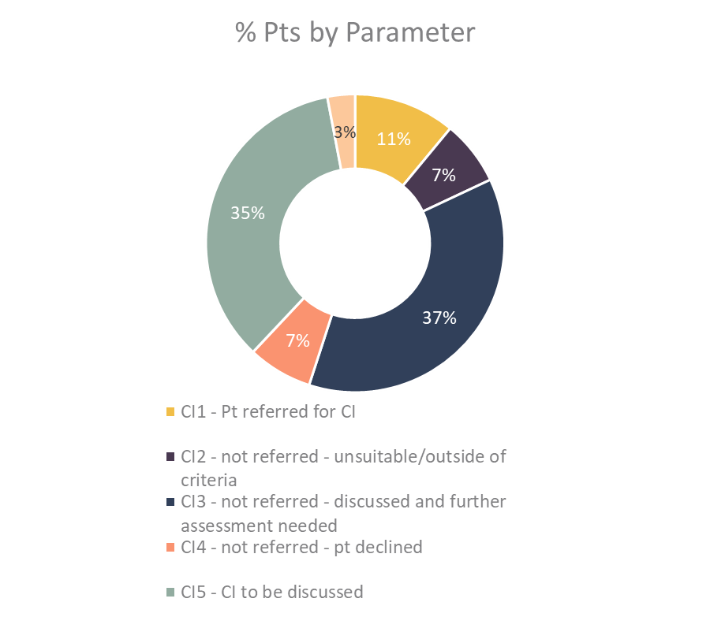
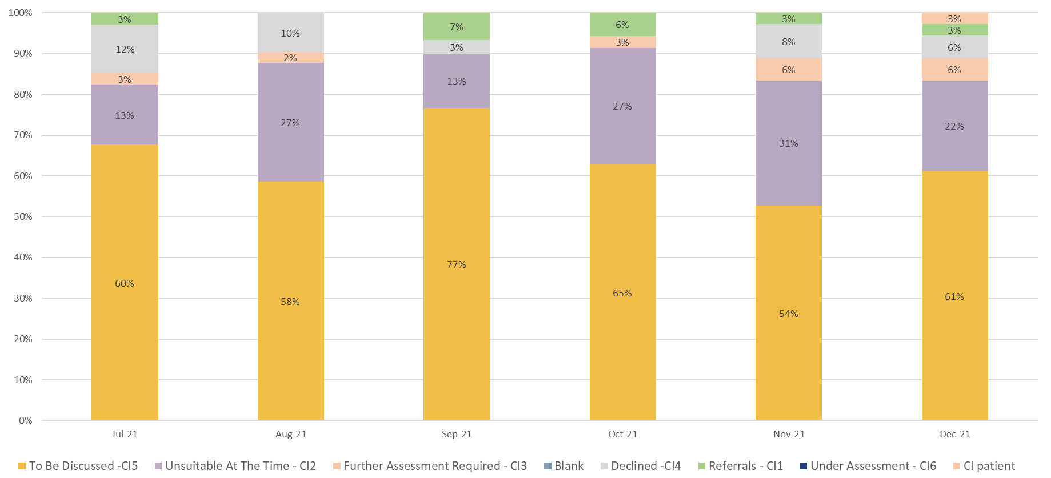
CI Audit Toolkit: How to use the audit results

Slide 13
The Audit Process: What to do with your data
First Audit
116 patients were identified. The search dates were March 2019 to July 2019. We completed the audit 2021.
Crystal report wasn’t used
Pre-CIRCA so the categories used were different
10% of the patients were referred for cochlear implant assessment and 90% were not.
8% of the patients who were not referred had a documented reason and 92% had no documented discussion.

Slide 14
The Audit Process: What to do with your data
Second audit
Completed after participating in the CIRCA audit CI 1, CI 2, etc were used
205 patients were identified, the search dates were July 2021 to December 2022. We completed the audit 2022
OUR STATS IMPROVED!
2021 audit 92% of the patients had no documented discussions, in the 2022 audit the percentage reduced to 69%.

Slide 15
How to use the audit results
The primary observation absent record-keeping.
We added a cochlear implant section to Auditbase hotkeys (direct referral, follow ups etc). In hopes that it may act as a reminder to identify patients who are within criteria and improve documentation.
We also added a note in the journal of patients with a mixed or conductive hearing loss to be considered for a CI assessment if BC thresholds worsen >60dB HL.
Does this patient meet cochlear implant referral criteria Y/N
Was a cochlear implant referral discussed Y/N
If YES, did the patient accept or decline referral?
If NO, why wasn’t it discussed?

Slide 16
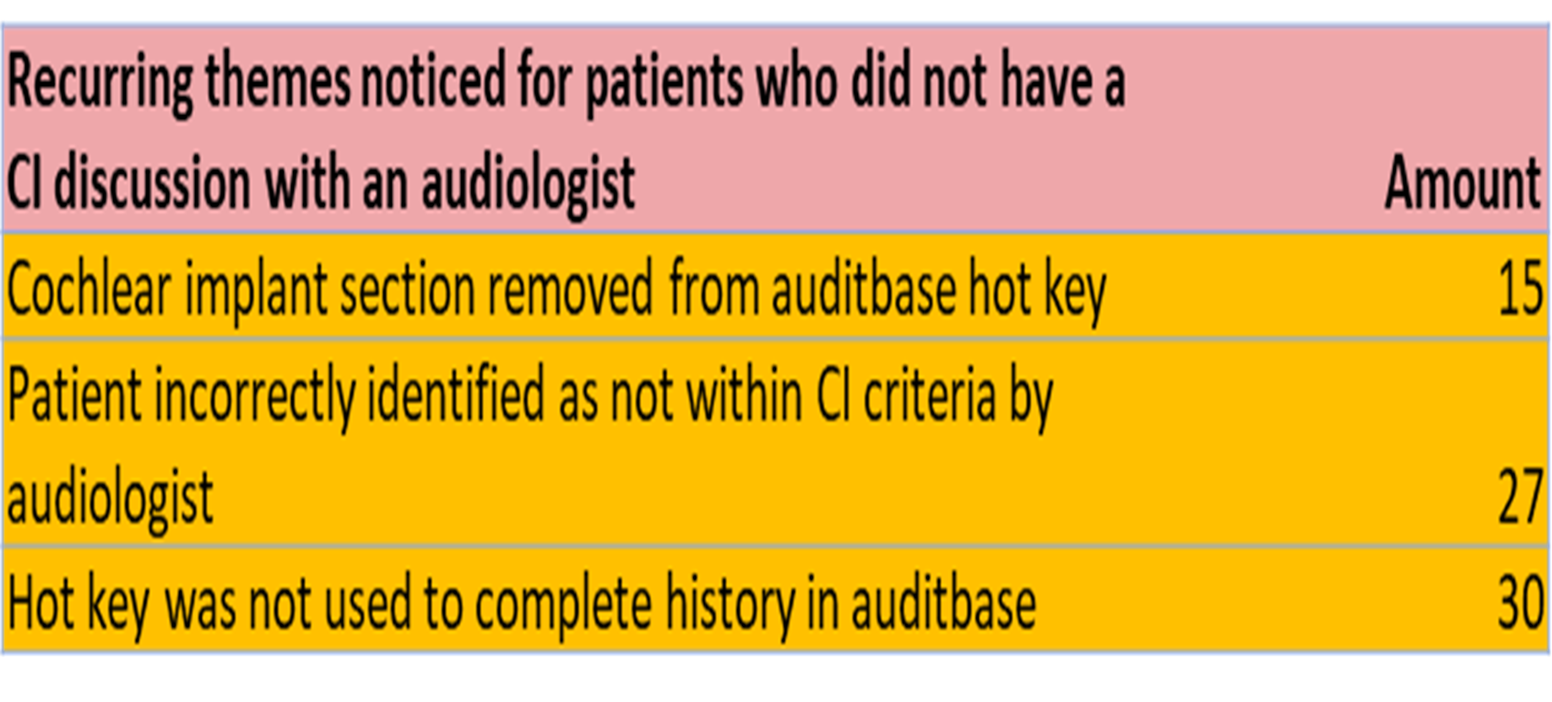
What to do with your data

Slide 17
What could your training look like
Patients where no action was documented were sent letters offering the opportunity to have a discussion with an audiologist regarding cochlear implants. https://www.baaudiology.org/app/uploads/2020/10/Considering-a-referral-for-a-cochlear-implant-leaflet.docx
CI assessment referral templates for WEHIP Bristol and Southampton Implant centre were created to simplify the referral process.
Created a Cochlear implant folder which includes all the audits, pdf resources from BCIG, Cochlear, Med-El, counselling flip chart and an appropriate referral quick guide.

Slide 18
What could your training look like
An additional cochlear implant letter was created for patients identified at clinics.
Emails sent to all staff reminding them of CI referral criteria and the importance of completing CI section in journal.
Invited a cochlear rep for internal training/discussion
Staff who are not comfortable discussing CI with a patient and or referring a patient to an implant centre are asked to forward patient info to CI champion.
A cochlear implant video booklet now available for our colleagues to use.
CI alert function on Auditbase

Slide 19
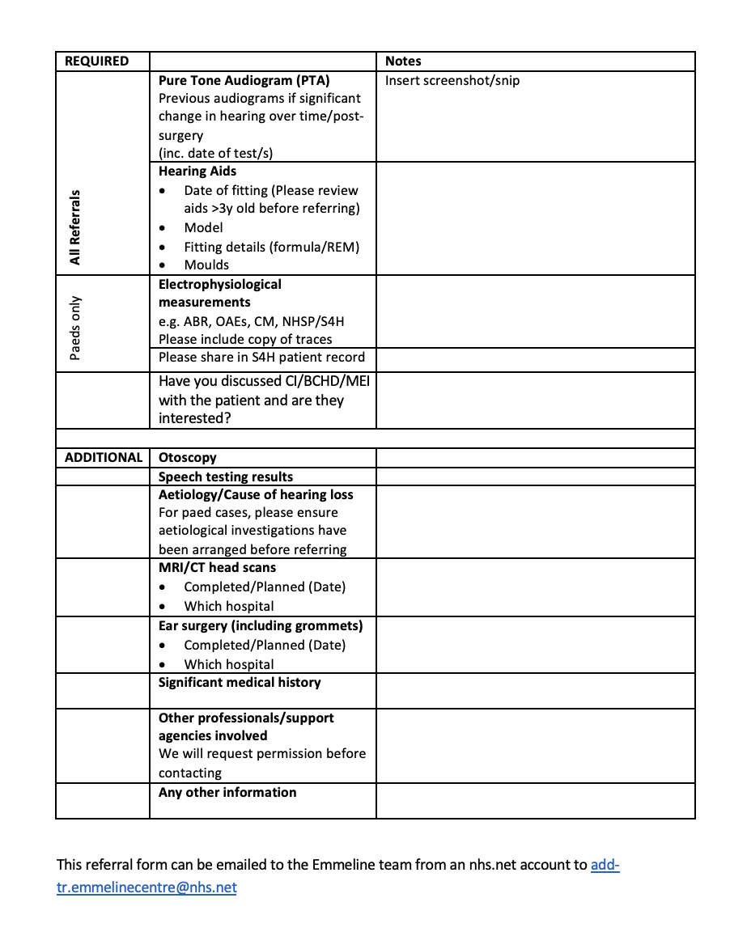
Emmeline Centre CI referral template
Notes:
Contacting your local CI service is the best way to ensure you include all the relevant information in your referral. They may have a template they can share with you.
Here is an example of a referral template.
CLICK TO ADD GREEN BOX AROUND PATIENT DETAILS
You would include the adult’s contact details, including their preferred method of contact and interpreter needs.
CLICK
Supply their current audiogram, and as many previous audiograms as you have available.
CLICK
Share details of their hearing aids, including fitting date, moulds .
CLICK
Give a brief summary of the person’s knowledge of and thoughts about implants.
CLICK
Additional information you can provide if available includes speech perception test results, the cause of hearing loss and how it’s progressed over time, previous MRI or CT head scans, history of ear surgery, significant medical history, cognition, and whether any other professionals or support agencies are involved.
But if you don’t have this information, don’t worry, just refer.
Copy your referral to both the hearing aid user, and to their GP.

Slide 20
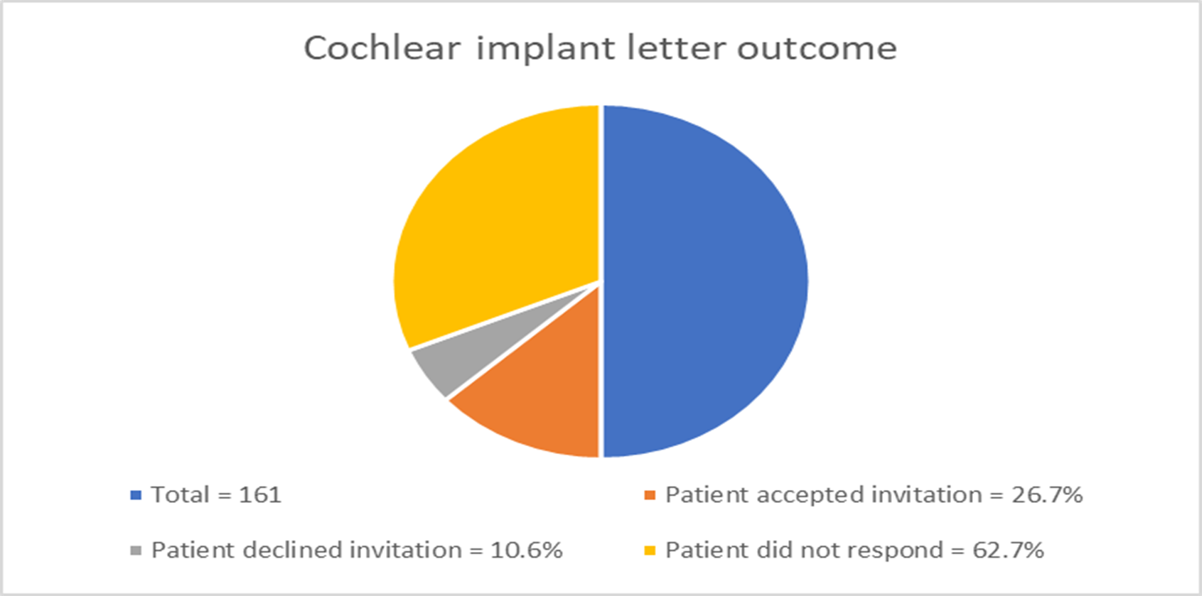
CI Audit Toolkit: Ongoing Audit

Slide 21
CI Audit Toolkit: How to use the audit results

Slide 22
Resources
NICE Guidance
Putting NICE Guidance into practice. A resource impact report
AoHL Cochlear Implants policy statement
BAA/BCIG Managing Expectations Factsheet
BAA/BCIG_Factsheet for Patients
WHO 2017 Global costs of unaddressed hearing loss and cost effectiveness of interventions
BAA Onward referral guidance https://www.baaudiology.org/app/uploads/2023/04/Onward-Referral-Guidance-for-Adult-Audiology-Service-Users-Sept-23.pdf
British Cochlear Implant Group
www.bcig.org.uk/patients.aspx
www.baaudiology.org/professional-information/cochlear-implant-champions/
Cochlear Implant International Community of Action
National Cochlear Implant Users Association
Hear Together Reports
Adult Cochlear Implant Action Group
Insights into life with a cochlear implant
Advanced Bionics
Cochlear
MED-EL
Notes:
So, as we begin to wrap up, we really hope that this session has demystified adult cochlear implant referrals for you.
Some of you might already be confident in this area, but for others this webinar might be a first step on your journey to confidence.
So, here are links to lots of resources. These will help you understand policy, the technology, guide your counselling, and includes good quality information you can share with eligible adults.
Keep up to date on policy guidance and make use of professional bodies like the British Academy of Audiology, including its Cochlear Implant Champions scheme; the British Cochlear implant group, users’ groups, and the CI manufacturers, who all have well-developed schemes for informing and engaging eligible adults.

Slide 23
Contact details
sam.blakemore1@nhs.net
lushinka.gopichand@esneft.nhs.uk
nicaida.samuel-huggins@somersetft.nhs.uk

